Slide 1
HTTP
The protocol:keep alive
Http Method
The Request Body
Cookies:CookieManager and CookieStore

Slide 2
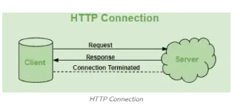
introduction of HTTP
HTTP (Hypertext Transfer Protocol) is a fundamental protocol of the Internet, enabling the transfer of data between a client and a server. It is the foundation of data communication for the World Wide Web. HTTP provides a standard between a web browser and a web server to establish communication. It is a set of rules for transferring data from one computer to another.

Slide 3
Protocol
A protocol is a set of rules and standards that define how data is transmitted and received between devices in a network. It specifies how communication starts, how data is formatted, how it is sent, and how errors are handled. Without protocols, computers would not be able to communicate with each other properly.

Slide 4
HTTP connections use the TCP/IP protocol for data transfer. For each request from client to server, there is a sequence of four steps:
1. The client opens a TCP connection to the server on port 80, by default; other ports may be specified in the URL.
2. The client sends a message to the server requesting the resource at a specified path. The request includes a header, and optionally (depending on the nature of the request) a blank line followed by data for the request.
3. The server sends a response to the client. The response begins with a response code, followed by a header full of metadata, a blank line, and the requested document or an error message.
4. The server closes the connection.

Slide 5
The Protocol: Keep-Alive
Keep-Alive is a feature of the HTTP protocol that allows a single TCP connection to be reused for multiple HTTP requests and responses instead of opening a new connection for each request.
Without keep-alive, every request requires a new connection, which increases latency and network overhead. With keep-alive enabled, the connection remains open for a short period after a response, improving performance and reducing server load.
In HTTP/1.1, keep-alive is enabled by default unless explicitly disabled.
when you set up a TCP connection, you associate a set of timers. Some of these timers deal with the keepalive procedure. When the keepalive timer reaches zero, you send your peer a keepalive probe packet with no data in it and the ACK flag turned on. You can do this because of the TCP/IP specifications, as a sort of duplicate ACK, and the remote endpoint will have no arguments, as TCP is a stream-oriented protocol. On the other hand, you will receive a reply from the remote host (which doesn't need to support keepalive at all, just TCP/IP), with no data and the ACK set.

Slide 6
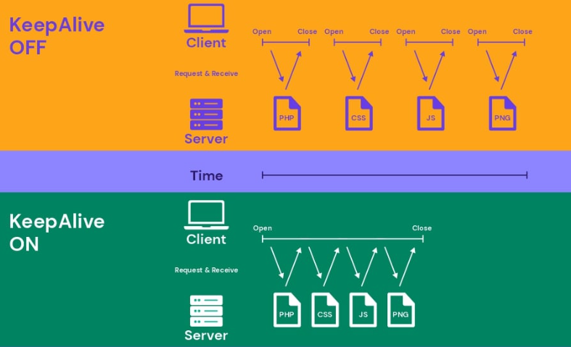

Slide 7
URL url = new URL("https://example.com");
HttpURLConnection con = (HttpURLConnection) url.openConnection();
// HTTP method
con.setRequestMethod("GET");
// Keep-Alive header
con.setRequestProperty("Connection", "keep-alive");

Slide 8
Methods of HTTP
GET: Used to retrieve data from a specified resource. It should have no side effects and is commonly used for fetching web pages, images, etc.
POST: Used to submit data to be processed by a specified resource. It is suitable for form submissions, file uploads and creating new resources.
PUT: Used to update or create a resource on the server. It replaces the entire resource with the data provided in the request body.
PATCH: Similar to PUT but used for partial modifications to a resource. It updates specific fields of a resource rather than replacing the entire resource.
DELETE: Used to remove a specified resource from the server.
HEAD: Similar to GET but retrieves only the response headers, useful for checking resource properties without transferring the full content.
OPTIONS: Used to retrieve the communication options available for a resource, including supported methods and headers.
TRACE: Used for debugging purposes to echo the received request back to the client, though it's rarely used due to security concerns.
CONNECT: Used to establish a tunnel to the server through an HTTP proxy, commonly used for SSL/TLS connections.

Slide 9
The Request Body
The request body is a part of an HTTP request that contains data sent from the client to the server. It is mainly used when the client needs to submit information to the server for processing.
The request body is the data sent from a client (like a web browser or app) to a server as part of an HTTP request, usually containing information for creating or updating a resource, commonly in formats like JSON or XML, used with methods like POST, PUT, or PATCH to send payload data beyond simple URL parameters.
The request body is commonly used with the following HTTP methods:
POST, PUT , PATCH
The request body can contain:
Form data (such as username and password)
JSON data
XML data
File uploads

Slide 10
Cookies
A cookie is a small piece of data created by a web server and stored on the client’s computer by the web browser. Cookies are sent by the server in the HTTP response and are automatically sent back to the server by the client with every subsequent request to the same domain.
HTTP is a stateless protocol, meaning it does not remember previous requests. Cookies are used to maintain state between multiple HTTP requests. They help the server identify users and remember information across sessions.
Cookies are commonly used for:
User authentication and login sessions
Storing user preferences
Tracking user activity
Maintaining shopping cart information
Each cookie has attributes such as name, value, domain, path, and expiration time.

Slide 11
CookieManager
CookieManager is a class provided by Java (java.net.CookieManager) that handles HTTP cookies automatically during network communication. It acts as a controller between HTTP connections and stored cookies.
When a server sends cookies in an HTTP response, CookieManager:
Accepts and stores cookies
Sends the stored cookies with future HTTP requests
Applies cookie policies such as domain and path matching
CookieManager removes the need for manually handling cookies in Java HTTP programs and simplifies session management.
CookieManager cookieManager = new CookieManager();
CookieHandler.setDefault(cookieManager);

Slide 12
CookieStore
CookieStore is an interface used by CookieManager to store and retrieve cookies. It is responsible for maintaining cookies in memory or in a persistent store.
CookieStore provides methods to:
Add cookies
Retrieve cookies for a given URI
Remove cookies
Manage expired cookies
CookieStore organizes cookies based on rules defined by the HTTP specification, such as domain and path restrictions.
CookieManager manager = new CookieManager();
CookieHandler.setDefault(manager);
URL url = new URL("https://example.com");
url.openConnection().getInputStream().close();
CookieStore store = manager.getCookieStore();

